Slide 1
The coalescent made fun and easy
Andy Clark and Ida Moltke
EMBO 2017 Population Genomics
Napoli – 22 May 2017

Slide 2
What is the coalescent?
A mathematical construct of the genealogical process describing a random sample of alleles from a population.
A way to model drift and mutation.
Only parameters are:
Population size (N)
Sample size (n)
Mutation rate (μ)

Slide 3
What good is the coalescent?
Makes the mathematics to derive many aspects of population genetics much easier.
Super-fast to simulate.

Slide 4
Objectives
To thoroughly understand why the coalescent is useful.
To be able to explain it to your grandmother.
To be able to code up a simulations, even if trapped in an elevator on a cruise ship with no internet.
To have FUN

Slide 5
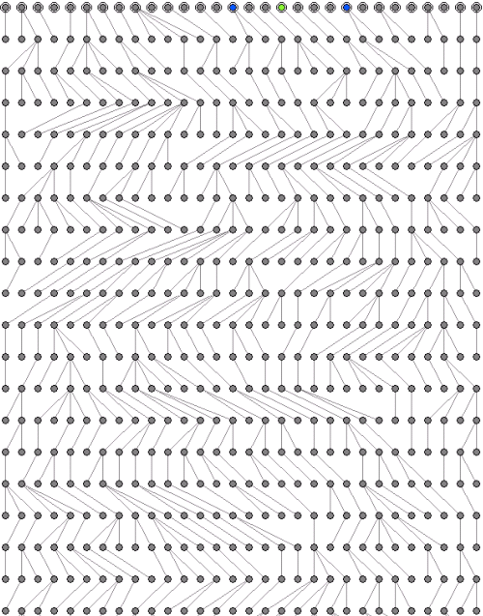
Past

Slide 6
Past
TIME

Slide 7
Past
TIME
Present

Slide 8
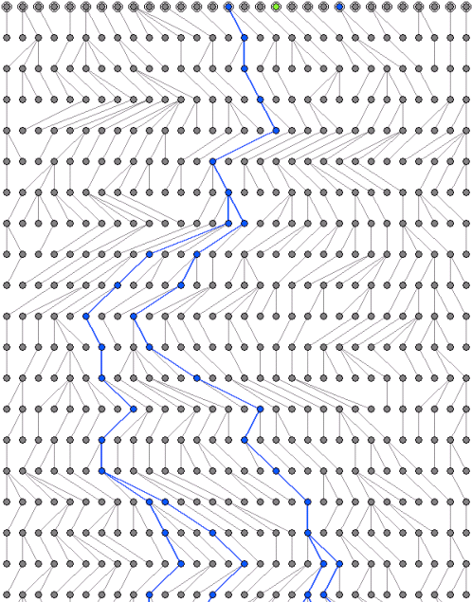
The coalescent considers a collection of genes observed in the present, and asks about their past genealogy.

Slide 9
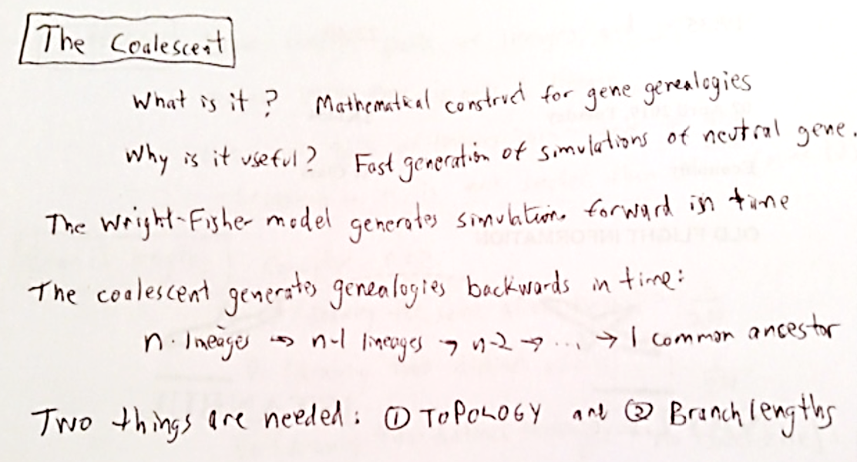

Slide 13
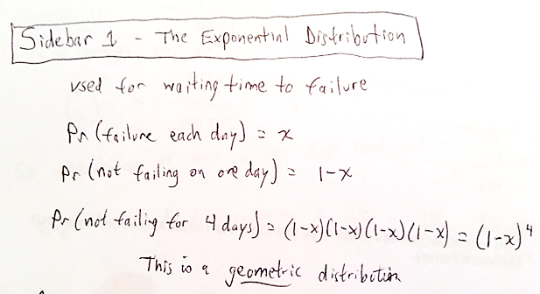

Slide 14
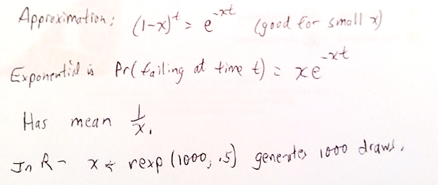

Slide 15
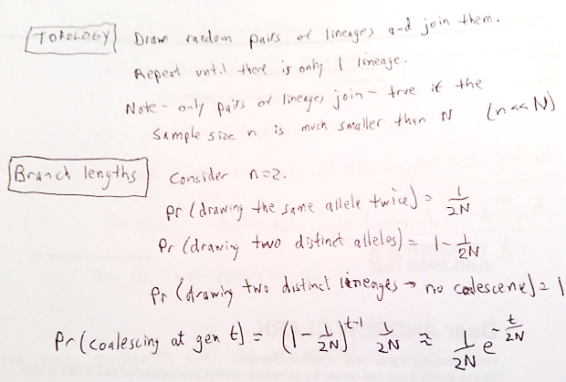

Slide 16
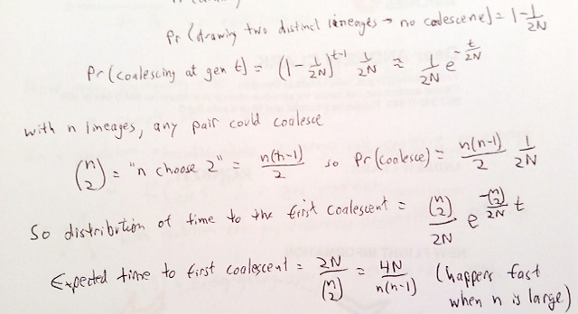
Probability of drawing the same allele twice 1/(2N)

Slide 17
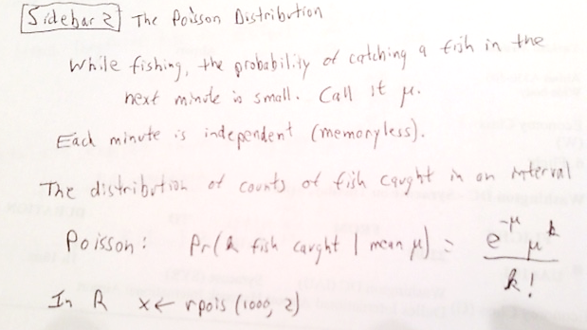

Slide 18
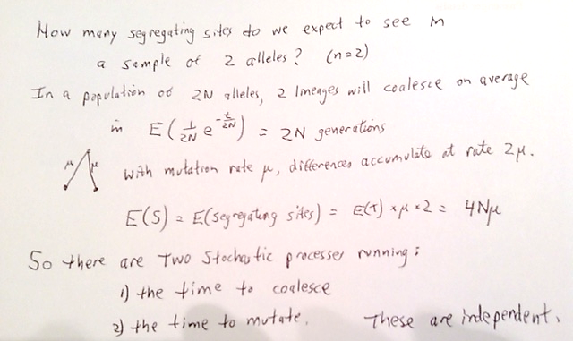

Slide 19
